Slide 1
THE case CONDITIONAL
Execution methods
exit status of the commands

Slide 2
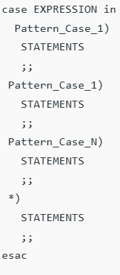
THE case CONDITIONAL
case is a keyword ,followed by EXPRESSION
EXPRESSION is the variable or value that is evaluated against different patterns (cases) to find a match.
Pattern_Case that represents a specific value or pattern to be compared with the EXPRESSION.
;; -end of each case block
*) similar to default in switch case in c language
esac - keyword,represents the end of each case statement
Exit status -
if no pattern matches -0
Otherwise - the executed body of the matched pattern case.

Slide 3
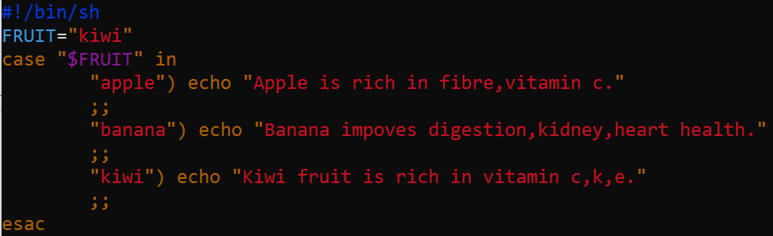

Example:
output:

Slide 4
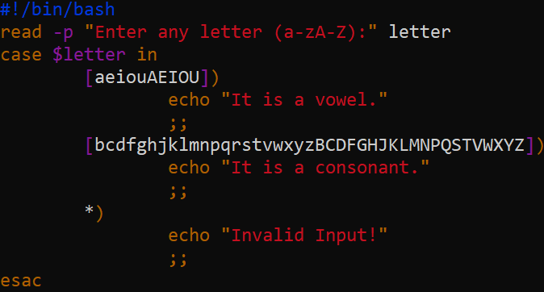
Using multiple case statement

Slide 5
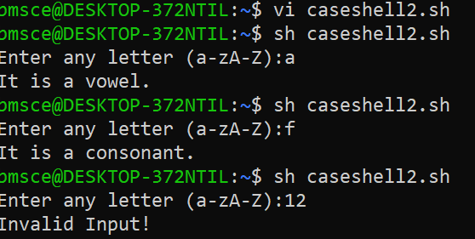

Slide 6
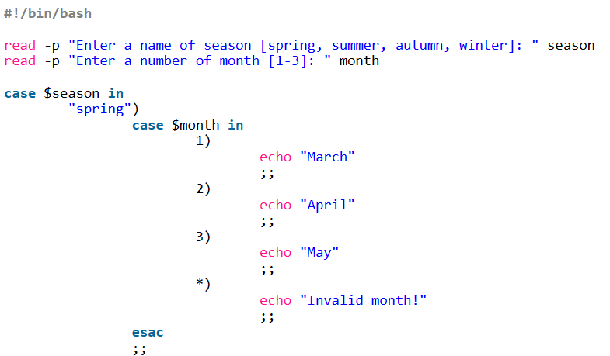
Nested case statement

Slide 7
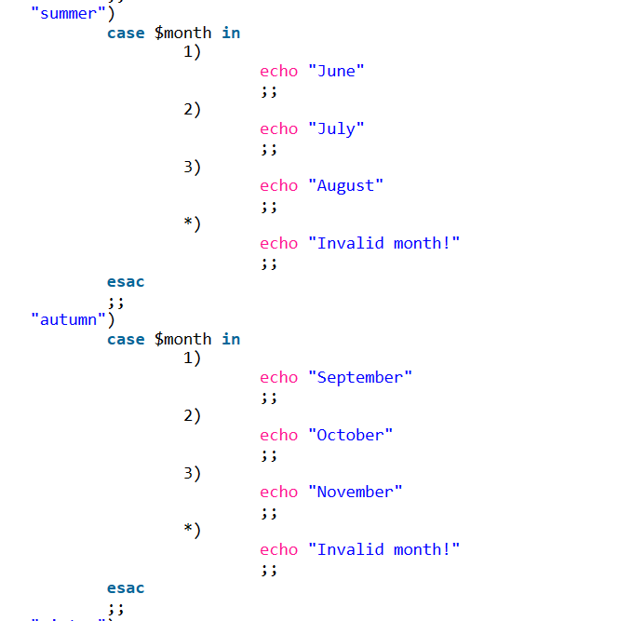
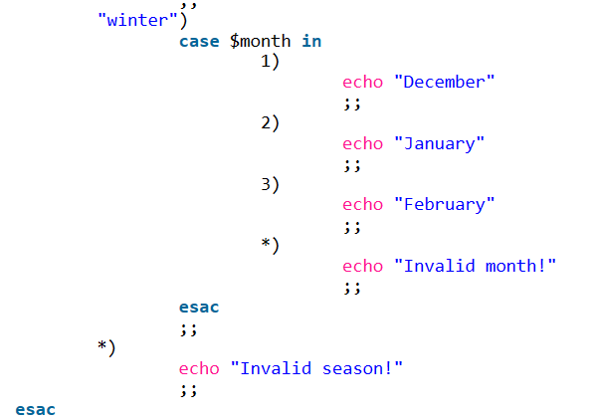

Slide 8
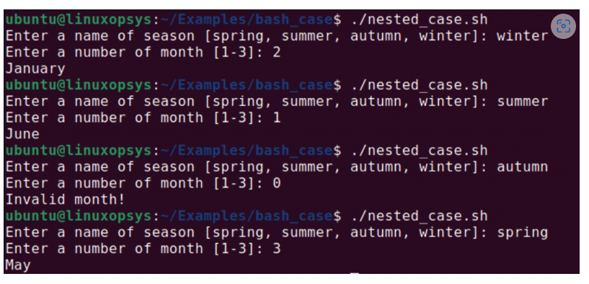

Slide 9
Execution methods
1. Execute Shell Script Using File Name
2. Execute Shell SCript by Specifying the Interpreter
3. Execute Shell Script Using . ./ (dot space dot slash)
4. Execute Shell Script Using Source Command

Slide 10
1. Execute Shell Script Using File Name
Use the shell script file name to execute it either by using it’s relative path or absolute path as shown below.
$ cd /home/unix
$ ./scriptfile
(or)
$ /home/unix/scriptfile

Slide 11
2. Execute Shell SCript by Specifying the Interpreter
Execute using sh interpreter
$ sh scriptfile
Execute using bash interpreter
$ bash scriptfile

Slide 12
3.Execute Shell Script Using . ./ (dot space dot slash)
It will execute the script in the current shell without forking a sub shell.
$ . ./scriptfile
4. Execute Shell Script Using Source Command
$ source ~/.bashrc

Slide 13
Exit status of the command
Syntax: exit
0- successful
non-zero -unsuccessful
An exit code, also known as an exit status, in Linux is a numerical value returned by a command or program to indicate its execution result.
This code provides information on whether the command completed successfully or encountered errors.

Slide 14
In Linux, the exit codes range from 0 to 255,
with 0 representing success
1-255 indicating various failure conditions
Why Are Exit Codes Important?
Error Handling
Control Flow
Feedback
Integration
Debugging

Slide 15
List of Key Exit Codes in Linux
0 | Success
1 | General Error—A catch-all exit code for a variety of general errors. Often used when the command or program encounters an error, but no specific exit code is available for the situation.
2 | Misuse of shell built-ins—Indicates incorrect usage of shell built-in commands or misuse of shell syntax.
126 | Command cannot execute—The command was found, but it could not be executed, possibly due to insufficient permissions or other issues
127 | Command not found—The command was not found in the system's PATH, indicating that either the command does not exist or the PATH variable is incorrectly set.
128 | Invalid exit argument—Returned when a script exits with an invalid argument. This usually indicates an error in the script itself.
128+N | Fatal error signal N—Indicates that the command or program was terminated by a fatal error signal. For example, an exit code of 137 (128 + 9) means that the command was terminated by a SIGKILL signal.
130 | Script terminated by Control-C—Indicates that the command or script was terminated by the user using Control-C (SIGINT signal).
255 | Exit status out of range—Returned when the exit status is outside the valid range (0 to 254).

Slide 16
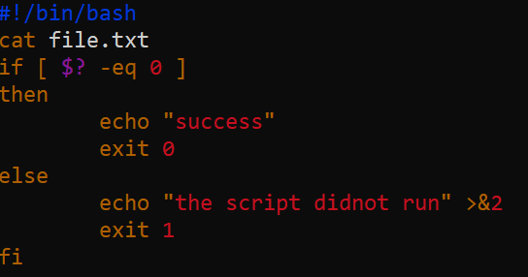

Slide 17


Output before creating file.txt in the current directory
Output after creating file.txt in the current directory
Contents of file.txt
Exit status is success

Slide 18
References:
Bash case Statement Syntax and Examples (phoenixnap.com)
An Overview of Linux Exit Codes | AgileConnection
Bash case Statement Syntax and Examples (phoenixnap.com)
Unix / Linux Shell - The case...esac Statement (tutorialspoint.com)
Bash Scripting - Case Statement - GeeksforGeeks

